Slide 1

MITIGATING UNCENSORED SOCIAL MEDIA UTILITY
Presenter Names
Collins Bunde I132/0858/2013
Edward Onyango I132/3025/2013

Slide 2
Project Objectives
To identify the risks of social media utility across Kenyan enterprises.
To identify the existing impact of the uncontrolled social media utility to some of the enterprises in Kenya.

Slide 3
Cont:
To suggest the implementation of local enterprise intelligent system of sentiment analysis for security reasons.
To suggest an effective social media strategy that defines, policy formulation guideline and risk assessment for the enterprise use within the Kenyan industrial realm
To create a model classifier that uses sentiment analysis techniques to analyze twitter sentiments regarding corporates and their brands.

Slide 4
Project Questions
Kenyan enterprises!!
Both private and government agencies
Why are they embracing social media??
How will they measure their success in the long run?? With the use of Social Media.
Social media strategy, policy, risk assessment, Local enterprise intelligence

Slide 5
Cont:
What are the risks that most enterprises are exposed to.?
Is the corporate perimeter defined?
How can they be prepared to deal with the risks and benefits it presents?
Proactive measures

Slide 6
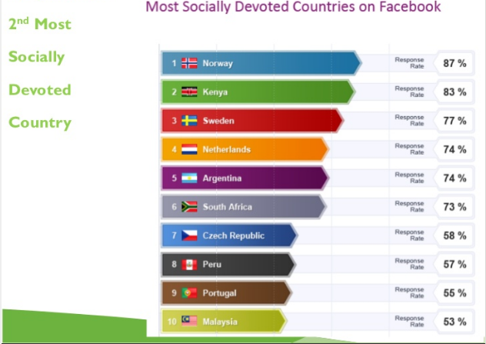
Why Kenya??

Slide 7
Why Social media Monitory?
An automated archiving system to help monitor activity could be beneficial to mitigate the risks of social media as well. Through gaining of insightful intelligence

Slide 8
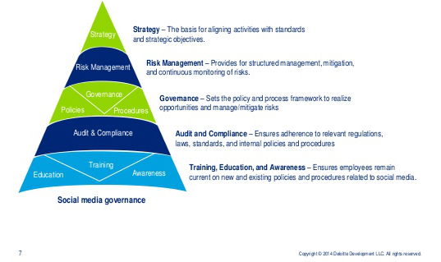
Enterprise Social Media plan
Photo courtesy of Delloite
Development LLC

Slide 9
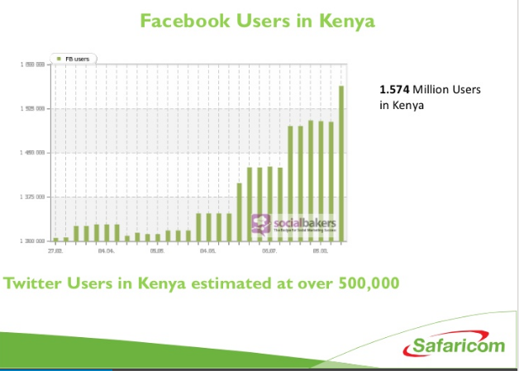
ESTIMATED SOCIAL MEDIA USAGE IN KENYA BY 2013

Slide 10
Methodology
Research Design
EXPLORATORY DESIGN
CASE STUDIES
REPORTS
WEBSITES
Blogs

Slide 11
Methodolgy (SDLC)
Sentiment Analysis:
Obtaining a data set – for both negative and positive messages
Training the classifier
Artificial Intelligence and Machine Learning Techniques.
Naïve Bayes Classifier Algorithm
Using Twitter

Slide 12
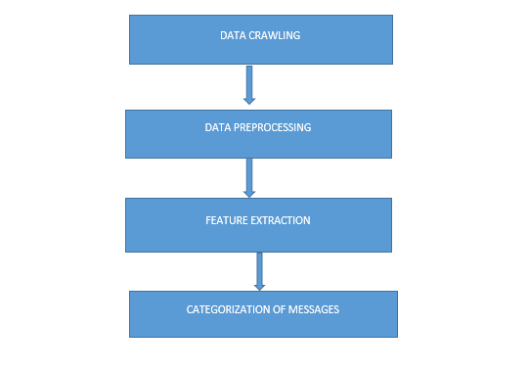
Methodology (SDLC)

Slide 13
Proposed System Architecture

Slide 14
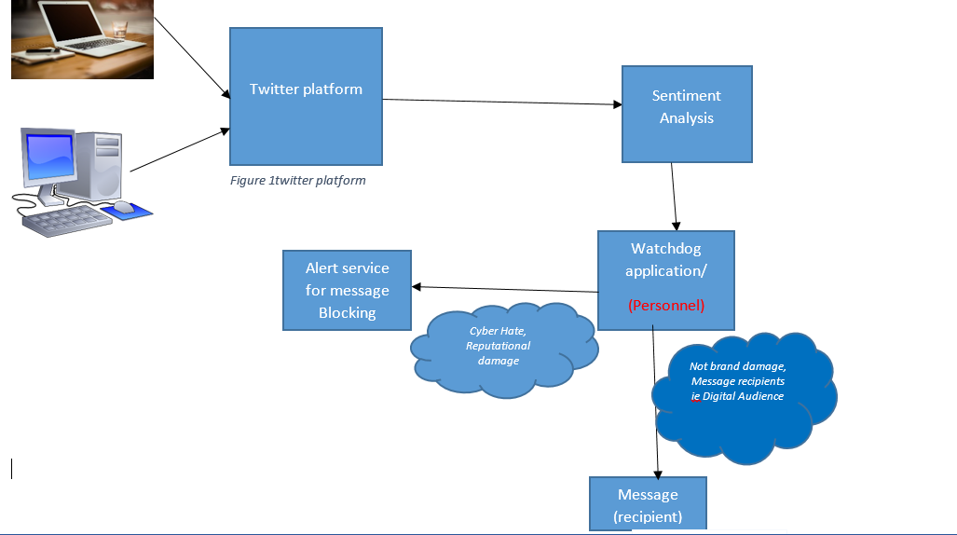

Slide 15
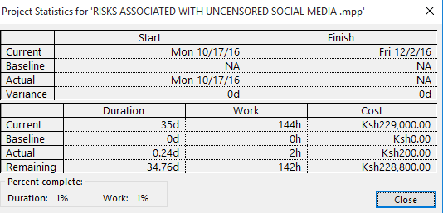
Current Project Status

Slide 16
Resources Required
1. Dedicated laptop for mining the twitter data. 2. Faster Internet access i.e Safaricom 3G or Airtel 3. Python Anaconda resource intensive 4. Research personnel 5. Programming in python

Slide 17
Technology
Benefits of this technology
Will be able to effectively address the needs each enterprise localized to its environment in achieving security in social media.
Standards Already adopted
The Umati Project for monitoring hate speech on social media, esp during the elections
Standards specifically being ignored
Using social media tools safely and securely enhancing privacy and reducing risks.
DYA: define your acronyms!

Slide 18
Thank You!
Questions

